Slide 1
PROJECT PRESENTATION
GAME OF THE AMAZONS
Available on: https://github.com/ehadziabdic/GameOfTheAmazons

Slide 2
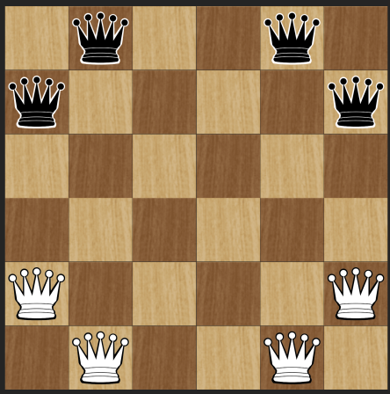
About the Game of Amazons
Invented in 1988 by Walter Zamkauskas of Argentina
Strategy game for two players, combining the movement of chess with the added space-restriction of Go.
Each player controls four Amazons (Queens).
Battle for space where players try to isolate their opponent by blocking of sections of board with arrows.
The Objective - be the last player capable of making a move.
This makes the Game of Amazons a fight for survival.

Slide 3
01
GAME RULES
Dev: Muhammed PaŠiĆ

Slide 4
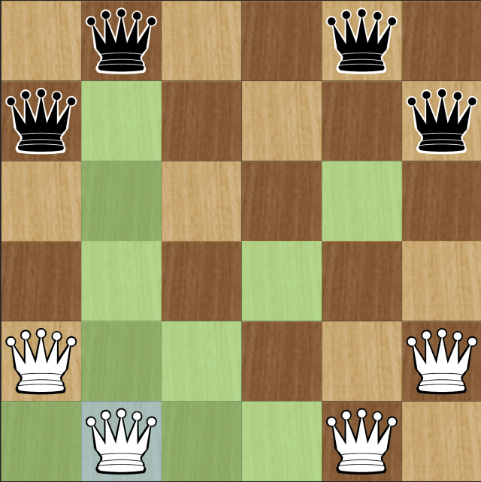
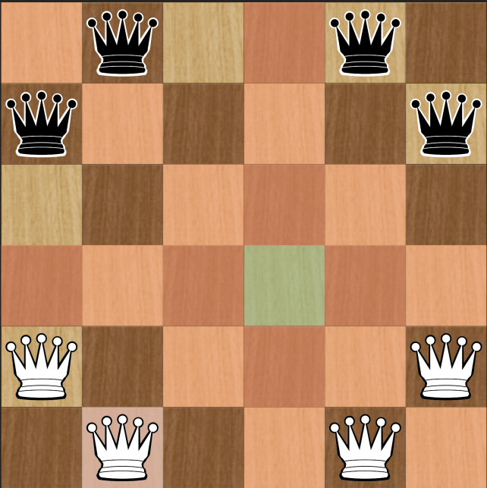
Game Rules - Player’s Turn
Legal moves for Amazon
Legal moves for the arrow
White goes first.
Shift one Amazon any distance (vertically, horizontally or diagonally) like a chess queen.
From this new position, fire your arrow to any empty square using the same queen like movement.
Current position

Slide 5
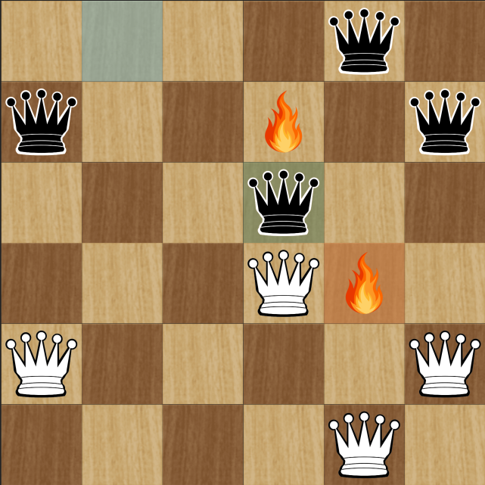
Game Rules - Player’s Turn
Old position of opponent
White goes first.
Shift one Amazon any distance (vertically, horizontally or diagonally) like a chess queen.
From this new position, fire your arrow to any empty square using the same queen like movement.
New position of opponent
Opponent’s new fire position

Slide 6
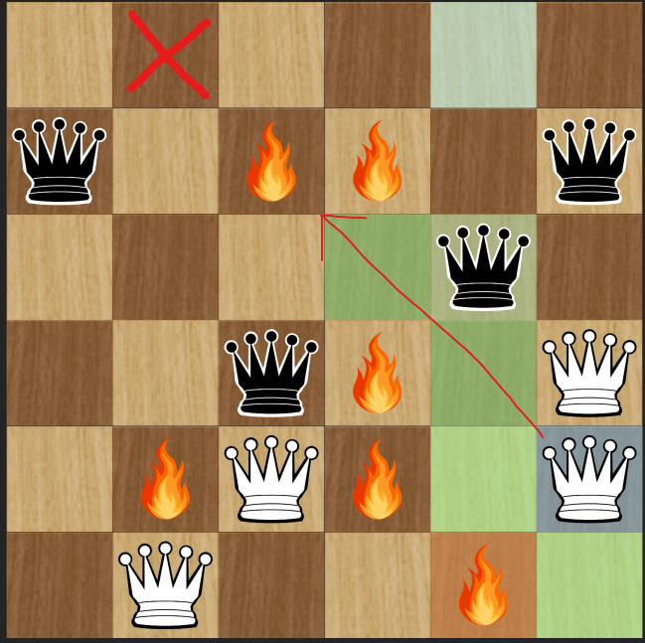
Game Rules - Restrictions
Once an arrow lands on a square, that square is off limits for the remainder of the game.
Neither Amazons nor arrows can pass through or jump over blocked or occupied squares.

Slide 7
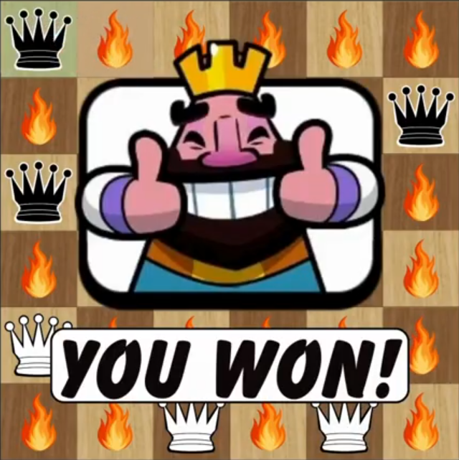
Game Rules - Victory
The game goes on until a player is walled in and has no legal moves left.

Slide 8
02
GAME INTERFACE
Dev: Emin HadŽiabdiĆ

Slide 9
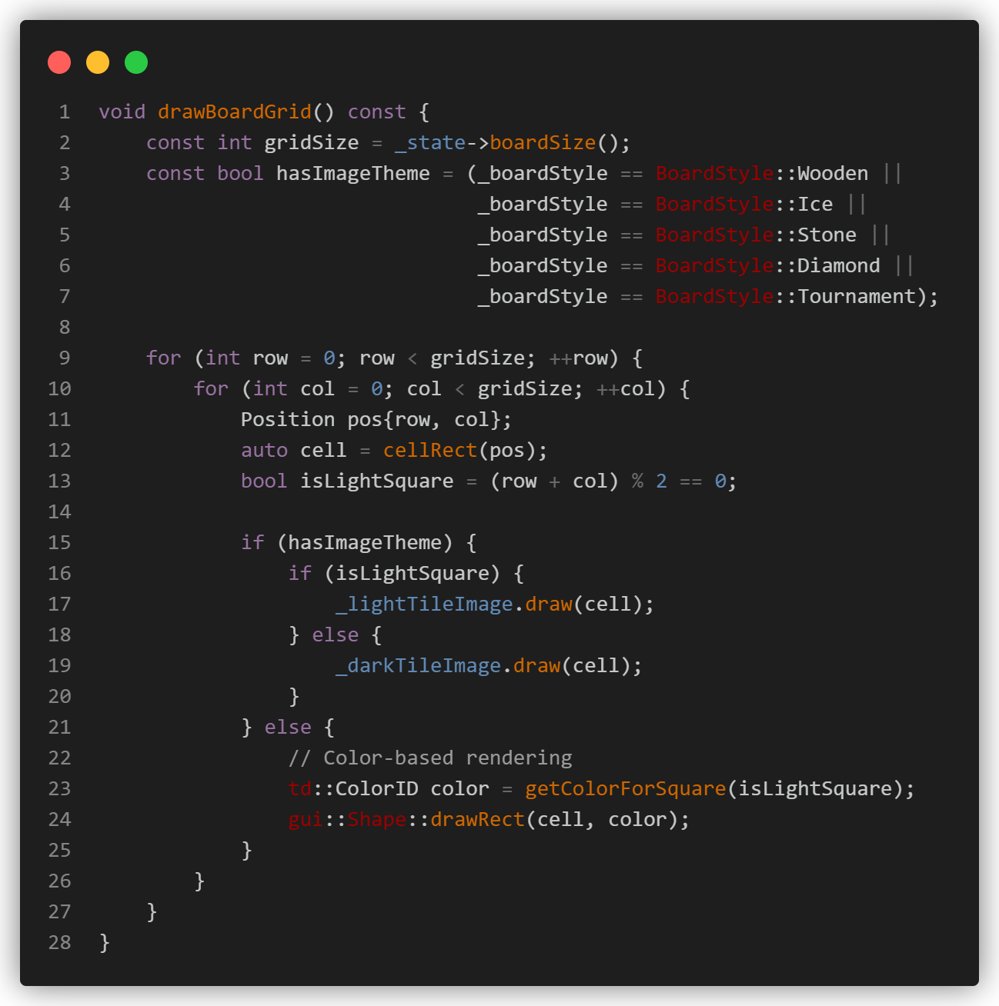
Game interface - Board Grid
Nested loop iterates every board position
Checkerboard pattern: (row + col) % 2
Image themes: Draw pre-loaded textures
Color themes: Use Shape::drawRect()
Efficient: Single draw call per tile
Notes:
We used a nested loop to go through every position on the grid.
To get that classic checkerboard look, we used a simple math formula: if the row plus the column is an even number, it’s a light square; otherwise, it’s dark.
Depending on the theme you choose, the code either draws a pre-loaded image texture or a solid color using the drawRect function.

Slide 10
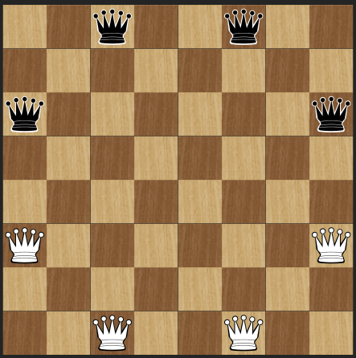
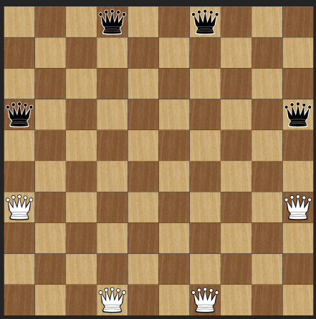
Game interface - Board Sizes
We implemented three distinct board sizes to cater to different player skill levels and time constraints.
6x6 (Small): Designed for fast-paced "Blitz" games
8x8 (Medium): A balanced, standard competitive size with moderate complexity.
10x10 (Large): Designed for "Professional" games, offering maximum strategic depth.
6x6
8x8
10x10
Notes:
We implemented three different board sizes to cater to different skill levels and time constraints.
The 6x6 'Small' board is great for fast-paced 'Blitz' games.
The 8x8 'Medium' board is the standard competitive size.
Finally, the 10x10 'Large' board is for 'Professional' matches where you need the most strategic depth.

Slide 11
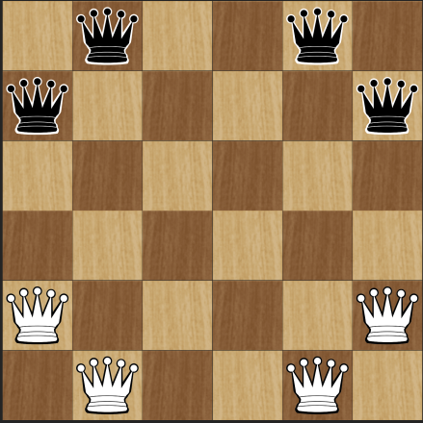
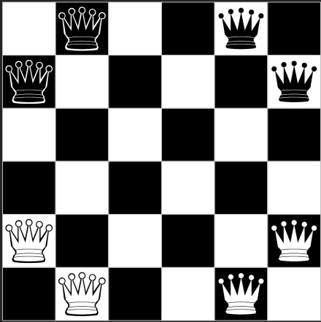
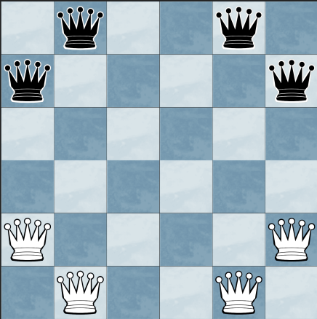
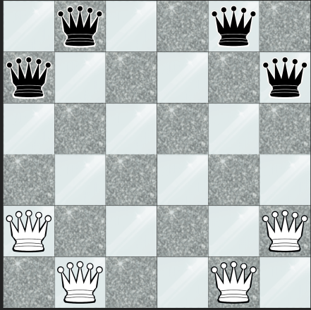
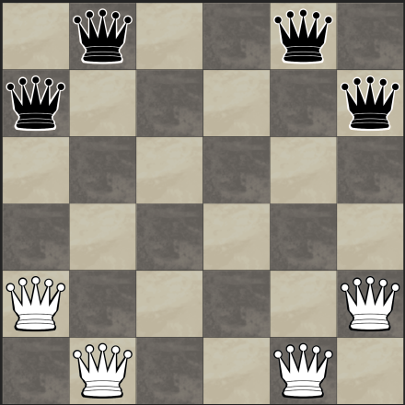
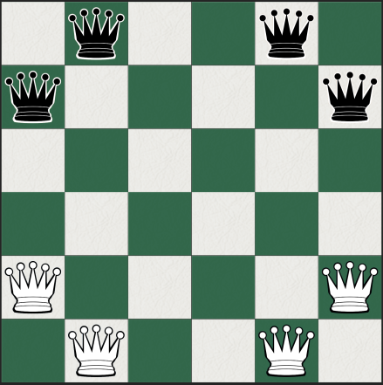
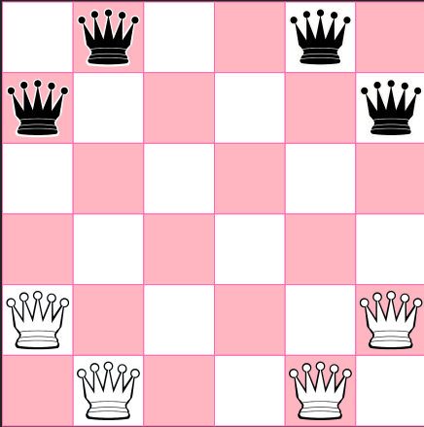

Game interface - Board Style
Available Themes:
Wooden
B&W
Tournament
Ice
Diamond
Stone
Bubblegum
Custom
Inspired by Chess.com
}
Provide professional and traditional look
}
Provide more modern feel
Exclusive theme just for female players
“We didn't just give users colors; we gave them a tool to create their own.”
Notes:
Visual variety is a big part of the user experience.
We offer traditional looks like 'Wooden' or 'Tournament,' and modern styles like 'Ice' and 'Diamond.'
We even included a 'Bubblegum' theme.
But my favorite feature is the 'Custom' theme, which gives users a tool to create their own style by picking their own colors for light and dark tiles using a color picker.

Slide 12
Game interface - Game Modes
Matchmaking Modes:
Player vs Player → Local multiplayer for social play.
Player vs AI → Test skills against our Minimax engine.
AI vs AI → "Spectator Mode" to observe the AI's decision-making
Animation Speed Slider:
A major UX addition that allows users to adjust the pace for AI vs AI matches from slow, cinematic movement to near-instantaneous play.
Notes:
Our game supports three modes: Player vs. Player for local fun, Player vs. AI to test your skills, and an 'AI vs. AI' Spectator Mode where you can watch two computers play each other.
To make Spectator Mode more useful, I added an animation speed slider. This allows you to adjust the pace from slow, cinematic movements to near-instantaneous play.

Slide 13
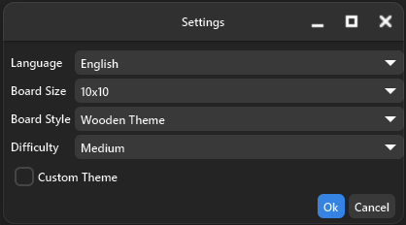
Game interface - Game Controls
Easy: The AI configured to be Easy Beatable, for beginners.
Medium: The AI configured to be Hardly Beatable, for intermediate players.
Hard: The AI configured to be Almost Unbeatable, for an expert-level opponent.
Choose language (6 options)
Choose board size (3 options)
Choose board style (7 options + custom)
Choose difficulty (3 options)
Notes:
This slide covers how users can customize their experience.
We have three AI levels: 'Easy' is beatable for beginners, 'Medium' is a challenge for intermediate players, and 'Hard' is designed to be almost unbeatable for experts.
Beyond difficulty, the settings allow you to choose from 6 different languages, 3 board sizes, and 7 board styles plus our custom color-picker mode.

Slide 14
Game interface - Game Controls
New Game Button: Resets the board state
Undo Button: Allows players to roll back queen movement if they don't want to make arrow placement.
Stop AI Button: Provides a "safe exit" by interrupting the Minimax search threads.
Status bar: Acts as a real-time guide for the player
Notes:
For the main gameplay, we have three essential buttons.
The 'New Game' button resets the board.
The 'Undo' button is very helpful—it allows players to roll back queen movement if they haven't placed an arrow yet.
We also added a 'Stop AI' button, which is a safety feature that kills the AI's search threads if they are taking too long.
At the bottom, We added a Status Bar which provide real-time feedback, showing whose turn it is and the current phase of the move.

Slide 15

Game interface - Navigator
We implemented a three-page system to keep the interface clean and organized while providing all necessary information to the player.
Game Page
The primary interactive layer where the board is rendered, animations occur (explosions, slides), and the actual gameplay takes place.
Move History Page
A log that records every coordinate-to-coordinate move and arrow shot. This allows players to review their strategy or see exactly where the AI outmaneuvered them.
Rules & Info Page
An in-game manual that ensures that even players unfamiliar with the Game of the Amazons can start playing immediately without external help.
Notes:
To keep the screen clean, we designed a three-page system using a Navigator and Switcher.
This allows the user to switch between the main Game page, the Rules, and the Move Logs without cluttering the main board area.
It provides a modern, 'App-like' feel to the desktop software.

Slide 16
03
GAME ENGINE
Dev: Armin Memišević

Slide 17
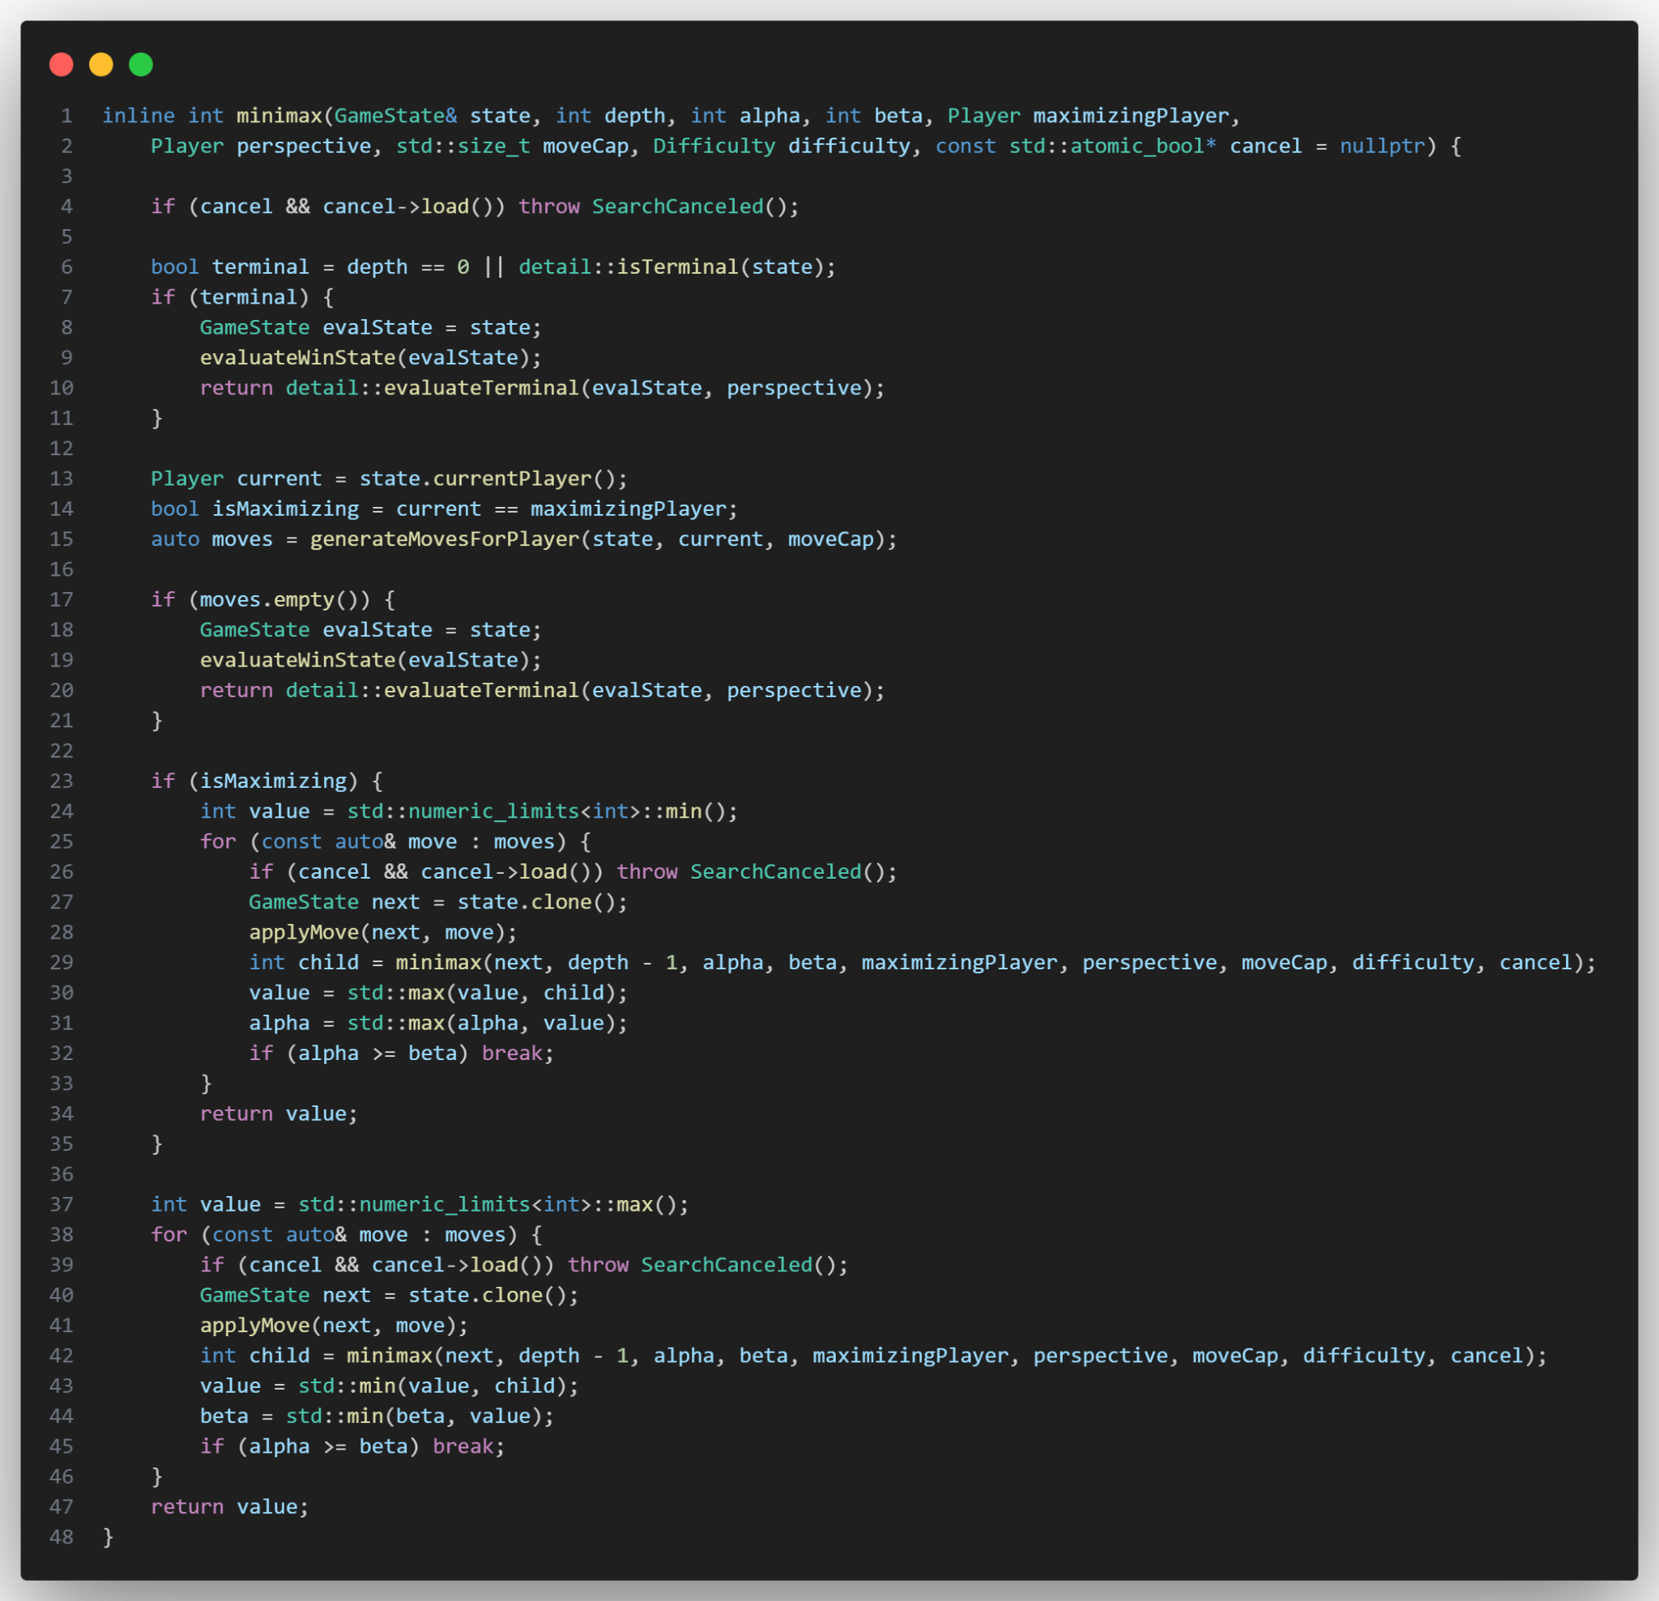
Game Engine - Core Algorithm
Minimax Algorithm
  What: The core decision-making logic that predicts future game states.
  How: It recursively simulates moves. It assumes the AI wants to maximize the score and the opponent wants to minimize it.
Alpha-Beta Pruning
  What: An optimization to make the search faster.
  How: If the AI finds a move that is clearly worse than a previous option, it immediately stops searching that branch (the if (alpha >= beta) break; line).

Slide 18
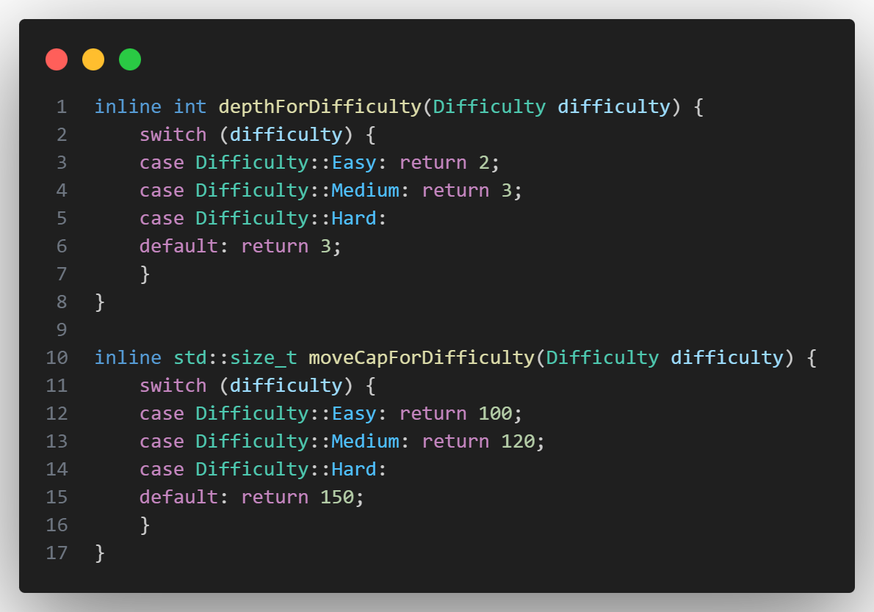
Game Engine - Search Constraints & Difficulty Scaling.
Search Depth
  What: Determines how many moves into the future the AI looks.
  How: * Easy: 2 moves ahead. Fast, but misses long-term traps.
  Medium/Hard: 3 moves ahead. This is the "sweet spot" for high-level play without long wait times.
Move Capping
  What: Limits the "Branching Factor" (the number of moves explored per turn).
  How: * In Amazons, one turn can have hundreds of possibilities. We cap this at 100–150 moves depending on difficulty.
    Why: This prevents the AI from "over-thinking" irrelevant moves, keeping the performance cost low and the game responsive even on weaker hardware.

Slide 19
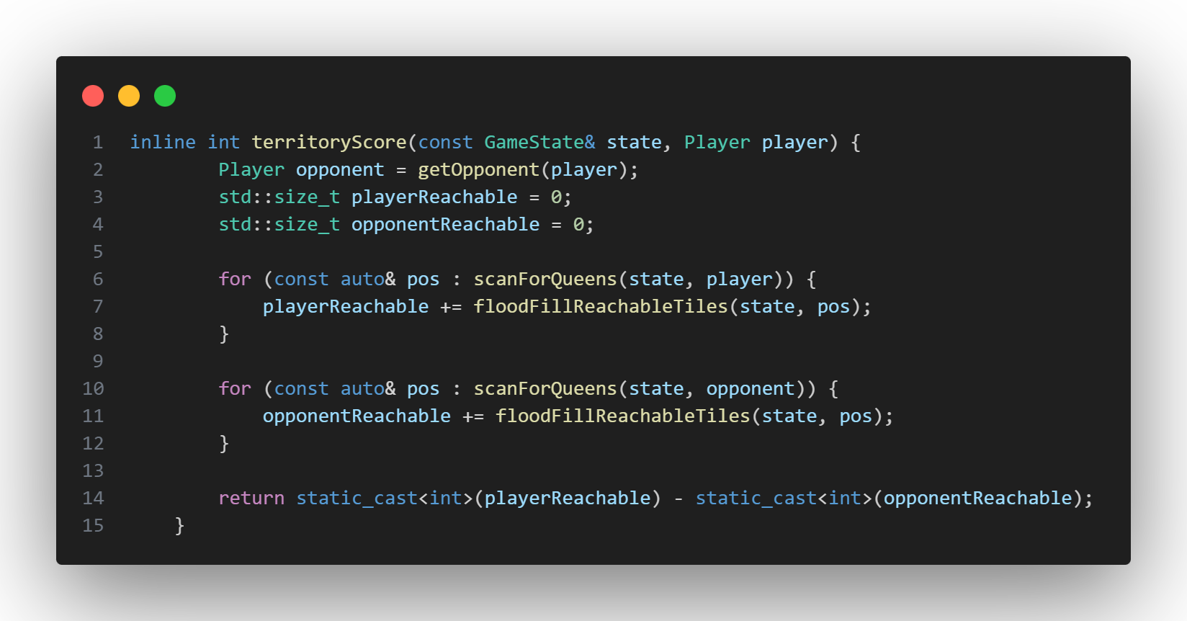
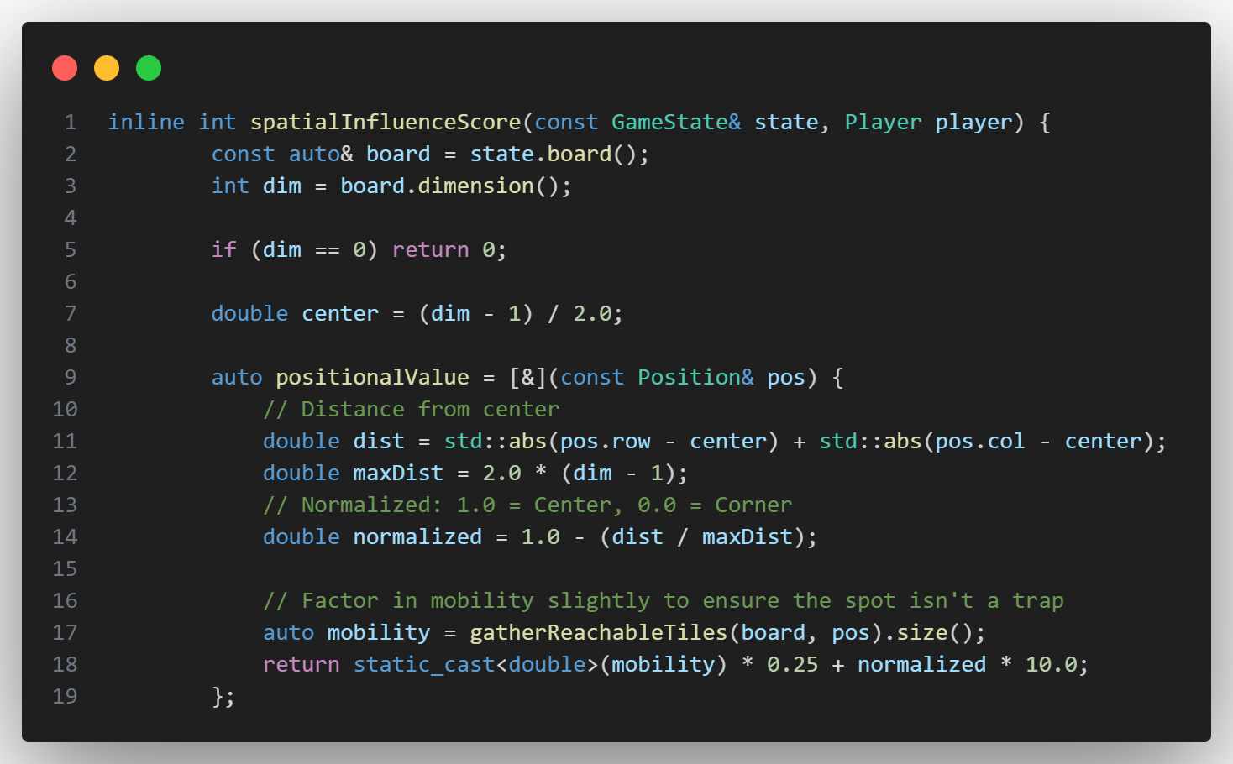
Game Engine - Heuristic Evaluation
Territory Score (Hard Mode)
  What: Calculates which player "owns" more of the board.
  How: Uses a Flood Fill algorithm (BFS) to count how many tiles our Queens can reach before the opponent.
Spatial Influence (Medium & Hard)
  What: Encourages the AI to control the center of the board.
  How: Calculates distance from the center. Center squares give higher scores; corners give lower scores.

Slide 20
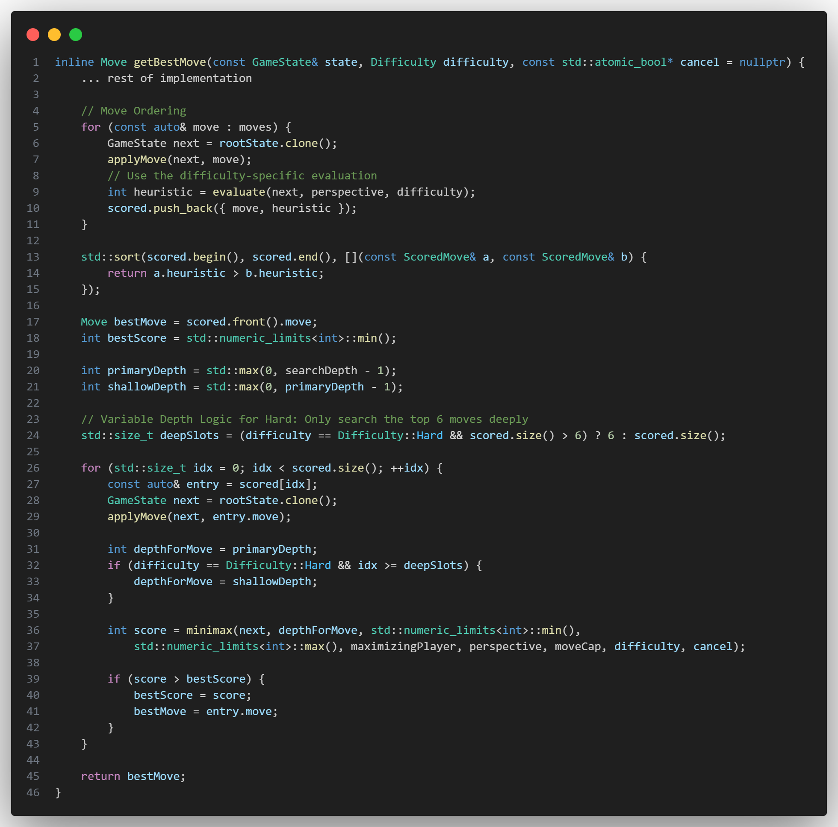
Game Engine - Performance & Difficulty Handling
Move Ordering
  What: Speeds up the AI by guessing which moves are best before checking them fully.
  How: We calculate a quick heuristic score for all moves and sort them. Checking good moves first makes Alpha-Beta pruning much more effective.
Selective Deepening (Hard Mode)
  What: Allows "Hard" difficulty to be smart but still responsive (fast).
  How:
    The Top 6 moves are searched to Full Depth (Deep).
    The remaining moves are searched to Shallow Depth (Fast).
    This avoids wasting time on obviously bad moves.

Slide 21
04
FEATURES

Slide 22
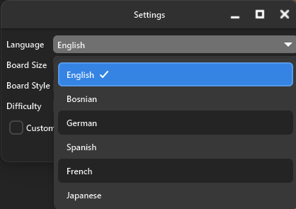
Available Languages
The game is designed to be inclusive and it offers full support for diverse global communities.
Multilingual support expands the potential user base significantly.
Our application currently features professional localization for six major languages:
English
Bosnian
German
Spanish
French
Japanese (Kanji)

Slide 23
Original Features vs Additional Features
Core Game Rules: Queen and Arrow placement, Path logic.
AI Engine: Minimax with Alpha-Beta pruning.
Heuristics: Spatial Influence & Territory Score
Difficulty Levels: Easy, Medium, and Hard.
Board Sizes: Small (6x6), Medium (8x8), Large (10x10)
Basic GUI: Responsive interface, interactive Queens, move highlights.
Primary Themes: Wooden and Black & White board styles.
Audio/Visuals: Core animations for movement/explosions and basic sound effects.
Dual Language Support: Interface available in Bosnian and English.
Expanded Theme Library: Six additional visual styles.
Custom Theme Creator: Integrated color pickers allowing users to define their own tile colors.
Additional Modes: PvP and Spectator mode
Multi-Language Expansion: Added support for total 6 languages.
Undo System: A state-stack implementation that allows players to take back their last move.
Stop AI Functionality: Safety feature to stop deep calculations safely.
Animation Speed Control: Control of the pace of visual effects.
Move History Log: A text-based record of all actions during the match.
Page System: A three-page interface layout for Game, History, and Rules.
Full Compatibility: App is compatible with windows, mac-os and linux
Notes:
To wrap up, I want to compare our original plan with what we delivered.
We met all core goals, like the AI engine, board sizes, and basic GUI.
However, we went much further by adding an Undo system, a Custom Theme creator, and expanding to 6 languages.
We also added the Spectator mode and the Move History log to provide a much more polished feel to the application.

Slide 24
THANK YOU FOR YOUR ATTENTION

